Slide 1
Asymptotic Efficiency of Algorithms

Slide 2
Running Time
The multiplicative constants and lower-order terms of an exact running time are dominated by the effects of the input size itself.

Slide 3
Asymptotic Efficiency
When only the order of growth of the running time is relevant,
we are looking at asymptotic efficiency of algorithms.
We are concerned with how,
the running time of an algorithm increases with the size of the input in the limit, as,
the size of the input increases without bound.

Slide 4
Asymptotic Notation
Asymptotic notation applies to functions.
The functions to which we apply asymptotic notation will usually characterize the running times of algorithms.

Slide 5
θ notation
For a given function g(n), we denote by θ(g(n)) the set of functions θ(g(n)) = { f(n): there exist positive constants c1, c2, and n0 such that 0 ≤ c1g(n)≤ f(n)≤ c2g(n) for all n ≥ n0}

Slide 6
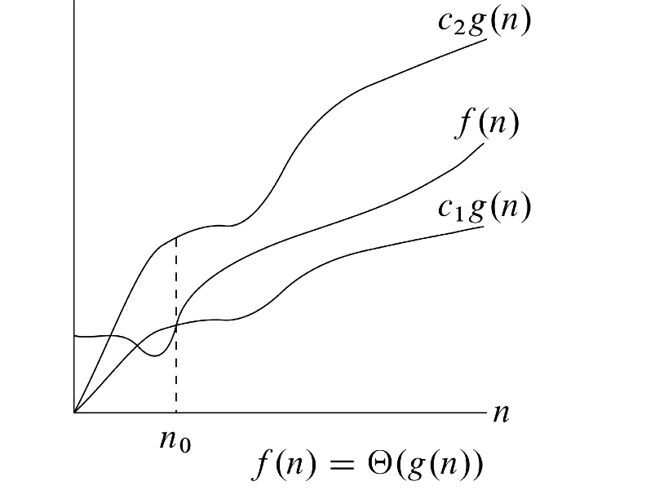
θ Notation

Slide 7
θ - notation
A function f(n) belongs to the set θ (g(n)) if there exist positive constants c1 and c2 such that it can be sandwiched between c1g(n) and c2g(n), for sufficiently large n.
The figure gives an intuitive picture of functions f(n) and g(n), where f(n) = θ(g(n)), for all values of n at and to the right of n0, the value of f(n) lies at or above c1g(n) and at or below c2g(n).

Slide 8
θ - notation
In other words, for all n ≥ n0, the function f(n) is equal to g(n) to within a constant factor. We say that g(n) is an asymptotically tight bound for f(n)

Slide 9
Computing constants c1, c2 and n0
Previously we introduced an informal notion of θ notation that amounted to throwing away lower-order terms and ignoring the leading coefficient of the highest-order term.
We can test this intuition for an example: n² - 3n = θ (n²)
c1n² ≤ n² - 3n ≤ c2n²
c1 ≤ - ≤ c2
1
2
1
2
1
3
2
n

Slide 10
O-notation
The θ-notation asymptotically bounds a function from above and below
When we have only an asymptotic upper bound, we use O-notation.
For a given function g(n), we denote by O(g(n)) the set of functions O(g(n)) = { f(n): there exist positive constants c and n0 such that 0 ≤ f(n) ≤ cg(n) for all n ≥ n0}
So O-notation is used to give an upper bound.

Slide 11
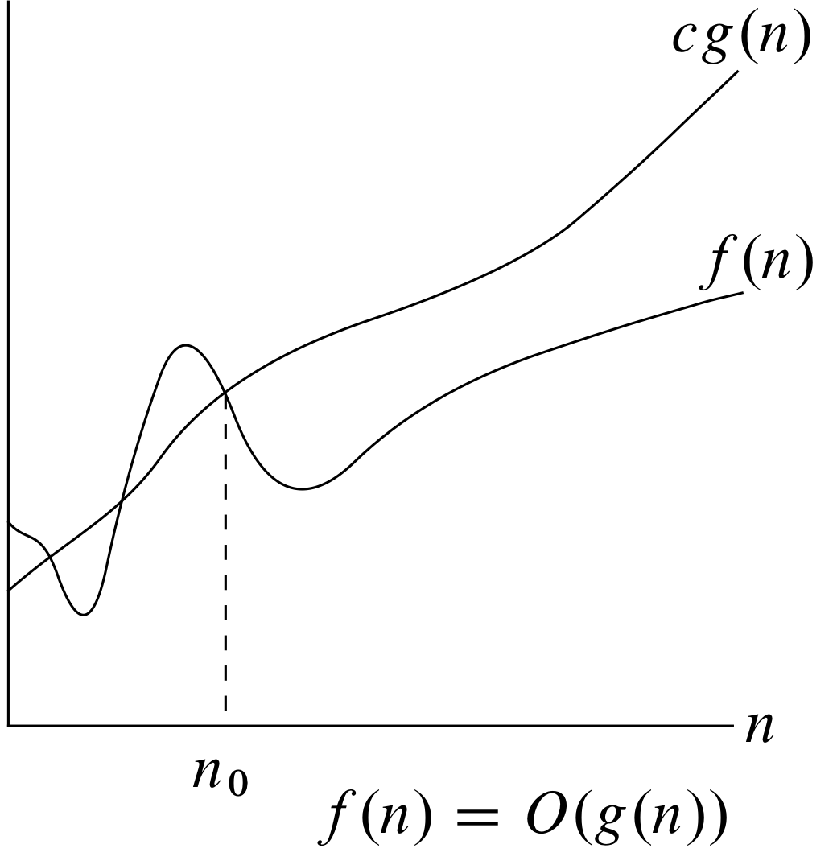
O notation

Slide 12
O-notation
Using O-notation, we can often describe the running time of an algorithm merely by inspecting the algorithm’s overall structure.
The doubly nested loop structure of the insertion sort algorithm yields an O(n²) upper bound on the worst-case running time.
Since O-notation describes an upper bound,
when we use it to bound the worst case running time of algorithm,
we have bound on the running time on the algorithm on every input.
However, θ(n²) does not imply a bound on the running time of insertion sort on every input.

Slide 13
Running time
The running time of insertion sort is O(n²)
When we say the running time is O(n²), we mean that there is a function f(n) that is O(n²) such that for any value of n, no matter what particular size of n is chosen, the running time of that input is bounded from above by the value f(n).
Equivalently, we mean that the worst-case running time is O(n²)

Slide 14
Ω-notation
Ω-notation provides an asymptotic lower bound.
For a given function g(n) we denote by Ω(g(n)) the set of functions Ω (g(n)) = {f(n): there exist positive constants c and n0 such that 0 ≤ cg(n) ≤ f(n) for all n ≥ n0}

Slide 15
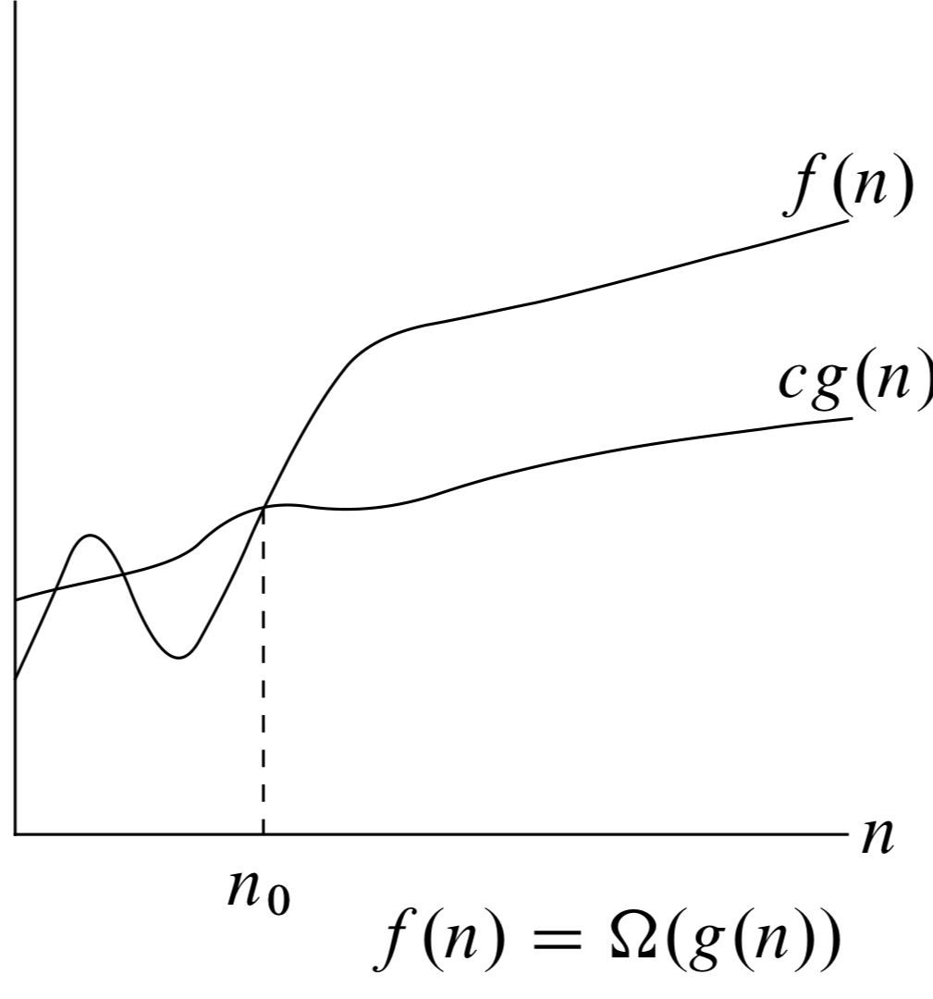
Ω-notation
For all values n at or to the right of n0, the value of f(n) is on or above cg(n)

